Slide 1

World Happiness Report
By:
Cara
Clarissa
Haja
Nathan

Slide 2
Why world happiness?
Each individual in this group come from different backgrounds and would like to analysis different countries happiness index.

Slide 3


Data cleaning
Used pandas to clean data and create new datasets
Needed to be same size
Column names needed to be easy to work with
Made values more uniform
An example of some columns we deleted were __________________

Slide 4
R
R Studio will be used to create a linear regression that represents the happiness of people across the world. Python will be used to clean data and to create data visualizations. Tableau will be used to create data visualizations and to create a happiness dashboard. SQL will be used to look up information and to join tables.

Slide 5
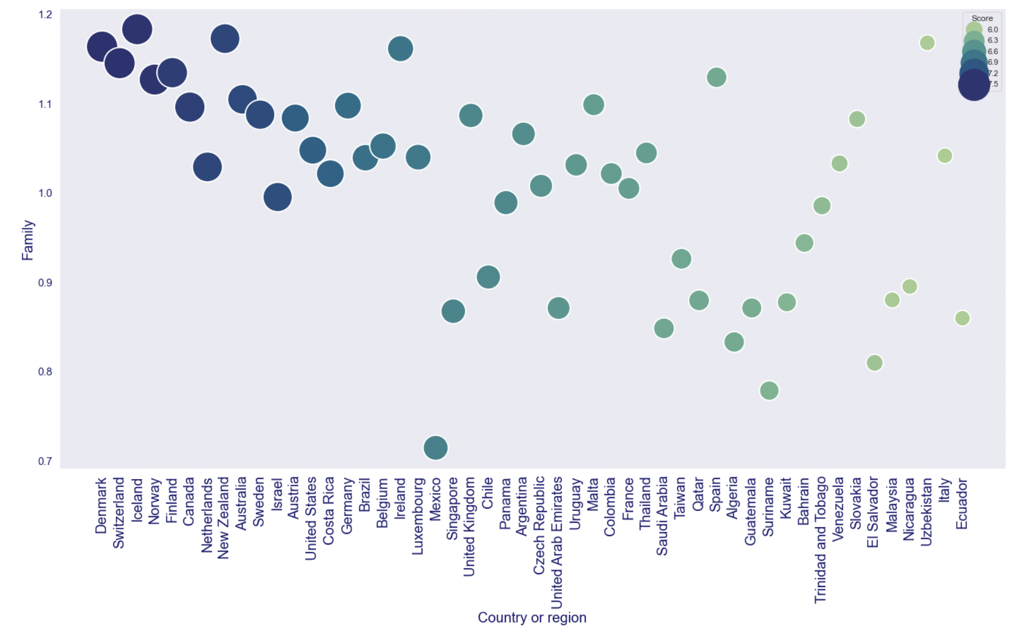
Visualization
This visualization was made using matplotlib and seaborn (a Python data visualization based on matplotlib). The scatterplot shows the top 50 countries and their corresponding Family values. The scale of each circle is based on the country’s happiness score.

Slide 6
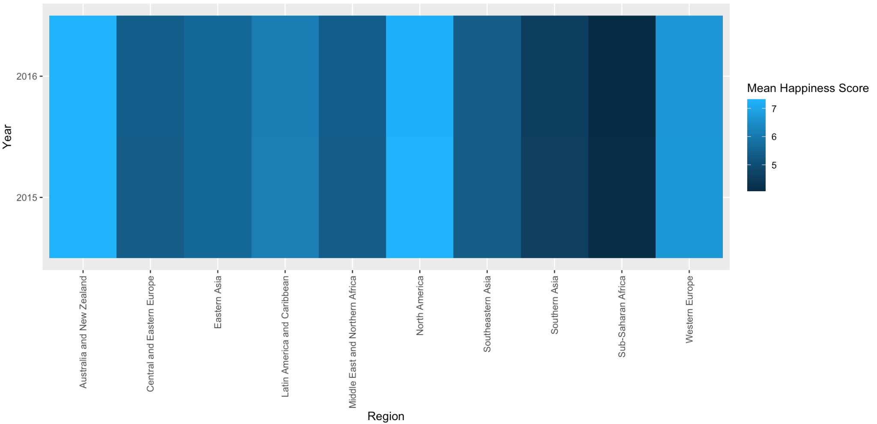
Visualization
This visualization was made on R using ggplot. This heatmap shows the average happiness score of each region and compares 2015 versus 2016.

Slide 7
Machine Learning
Preprocessed the data by dropping unnecessary columns
Determined features and set happiness score as target
Split the data into training and testing sets
Created models using 2015 and 2016 data separately
Performed a linear regression model - 0.74 and 0.73 accuracy
Random forest model - 0.73 and 0.69 accuracy
Also calculated and ranked feature importance
SVM model - 0.75 and 0.69 accuracy

Slide 8
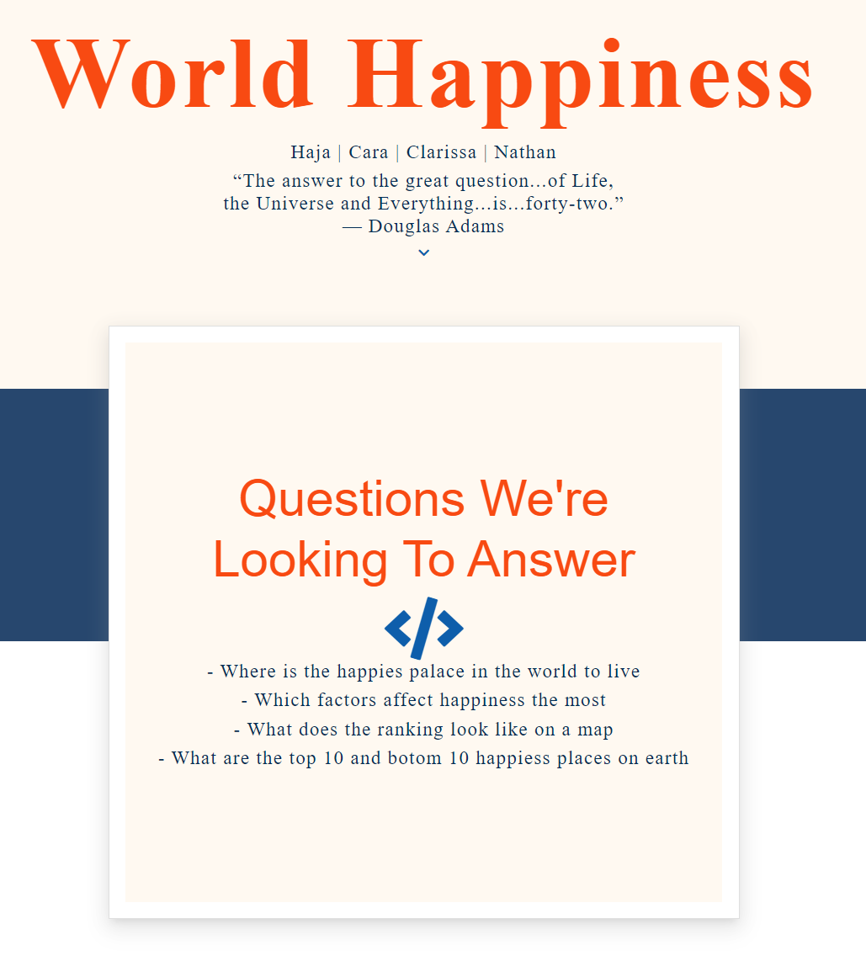
Our webpage

Slide 9


Project Resources
Thank you!
Github
Webpage

